Slide 1

Tutorial 10: Review
COMP 249 CCCE
Object-Oriented Programming II

Slide 2
Tasks
Lambdas
UML Class Diagrams
Access Modifiers
Inheritance & Polymorphism
Inner Classes
Abstract Classes & Interfaces
File I/O
Recursion
Generics

Slide 3
Lambdas
Lambda expression is a block of code that you can pass around so it can be executed later, once or multiple times (similar to a method)
Lambda expressions are used for defining anonymous expressions or nameless methods or functions
Lambda expressions are defined with help of Functional Interfaces
Introduced in Java 8
Functional interface (@FunctionalInterface) is an interface with only one abstract method. Examples: Runnable, Callable, Comparator, ActionListener, etc
Syntax examples:
() -> expression
(parameter1, parameter2) -> expression
(parameter1, parameter2) -> {
code block;
};

Slide 4
Lambdas
Lambdas are used to define implementation of a functional interface, bypassing the process of creating the class that implements the interface and instantiating it
Lambda expressions can be stored in variables if the variable's type is an interface which has only one method
You can pass method, that is lambda expression, as an Object
We can have local variables inside lambda expression
Local variables referenced from lambda expression must be final or effectively final (they are never modified)
Lambdas are similar to inner classes
You can pass method as an Object
*Code Example: Tutorial10_Lambdas

Slide 5
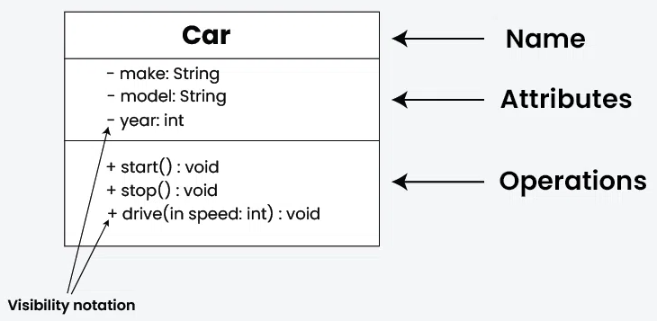
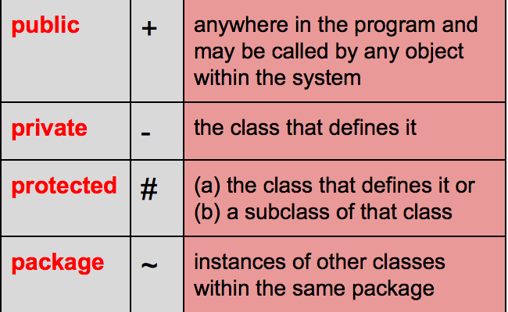
UML
UML (Unified Modeling Language) is a graphical language that is used for designing and documenting software created within the OOP framework
Developed along with OOP
Class diagram describes the types of objects in the system and the various kinds of static relationships that exist among them
Class diagrams also show the properties and operations of a Class and the constraints that apply to the way objects are connected
UML uses the term feature as a general term that covers properties and operations of a Class
https://www.geeksforgeeks.org/unified-modeling-language-uml-class-diagrams/
https://medium.com/@smagid_allThings/uml-class-diagrams-tutorial-step-by-step-520fd83b300b

Slide 6
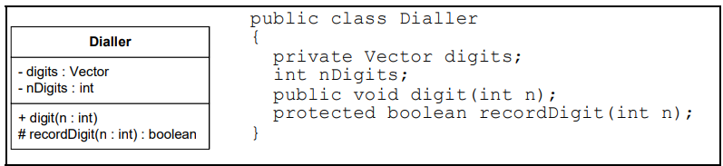
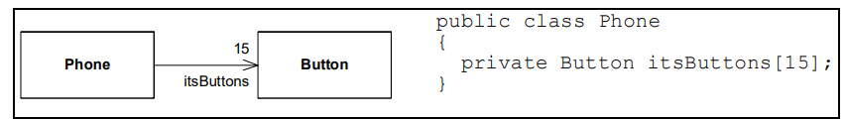
UML
UML for Java Programmers
Association between classes most often represent instance variables that hold references to other objects (“part-of” relationship)
Represented by a solid line between two classes, directed from the source class to the target class
F.e. The direction of the arrow tells us that Phone holds a reference to Button. The name near the arrowhead is the name of the instance variable. The number near the arrow head tells us how many references are held
UML for Java Programmers

Slide 7
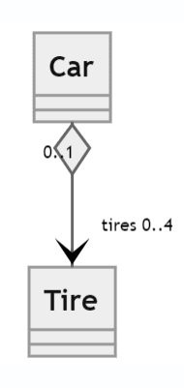
UML
Aggregation (“has-a”) special form of association that connotes a “whole/part” relationship
Represented by hollow diamond at the end of the association line which is connected to the class that represents the aggregate
The "whole" class can contain or aggregate instances of the "part" class. However, the "part" can exist independently of the "whole." This means that even if the "whole" object is destroyed, the "part" objects can still exist
A whole cannot be its own part, thus, instances cannot form cycles of aggregations. A single object cannot be an aggregate of itself; two objects cannot be aggregates of each other
class Car {
List<Tire> tires;
Car() {//Constructor}
boolean install(Tire aTire) {
if (tires.size() < 4 && aTire.install()) {
tires.add(aTire);
returrn true;
}
return false;
}
boolean remove(Tire aTire) {} } }
class Tire {
boolean isInstalled;
Tire() {…}
boolean install() {...}
void remove() {…}
boolean isInstalled() {…} }
https://coursepress.lnu.se/courses/object-oriented-analysis-and-design/02-theory/design_class_relations

Slide 8
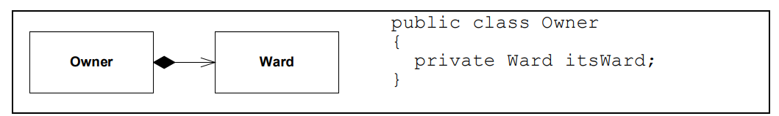
UML
Composition is special form of aggregation
Represented by filled diamond at the end of the association line
There can be no cycles of instances
The owner is responsible for the lifetime of the ward. If the owner is destroyed, the ward must be destroyed with it. If the owner is copied, the ward must be copied with it
An instance of a ward cannot be simultaneously owned by two owner.
UML for Java Programmers
UML for Java Programmers

Slide 9
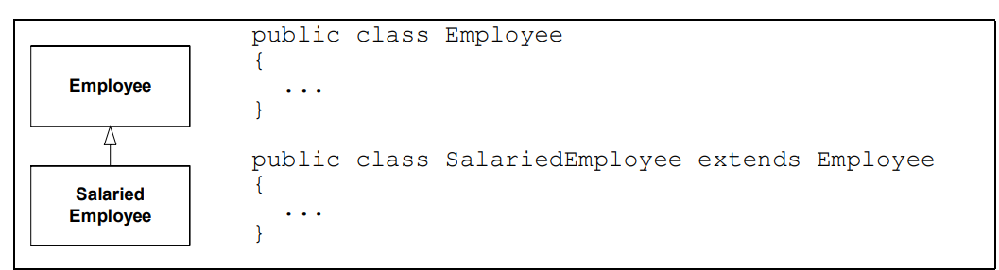
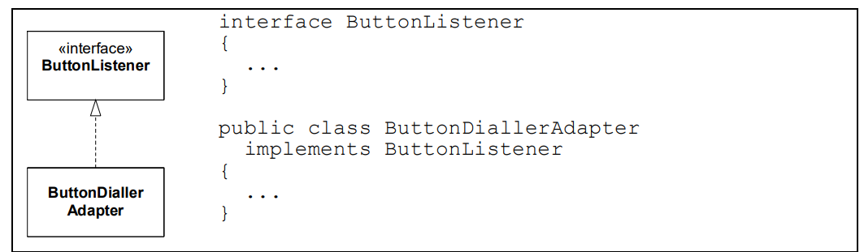
UML
Inheritance (“is–a”) arrows point at the base class
Represented by straight connected line with a closed arrowhead pointing towards the superclass
UML for Java Programmers
Realization relationship between the interface and the implementing class
Represented by dashed inheritance arrow
UML for Java Programmers

Slide 10
UML
Multiplicity indicates how many instances of a class can be associated with instances of another class (e.g., 1, 0..1, *, 1..*)
Objects can hold arrays or vectors of other objects; or they can hold many of the same kind of object in separate instance variables
Here are the allowable forms:
• Digit. The exact number of elements
• * or 0..* zero to many.
• 0..1 Zero or one. In Java this is often implemented with a reference that can be null
• 1..* One to many.
• 3..5 Three to five.
• 0, 2..5, 9..* Silly, but legal.

Slide 11
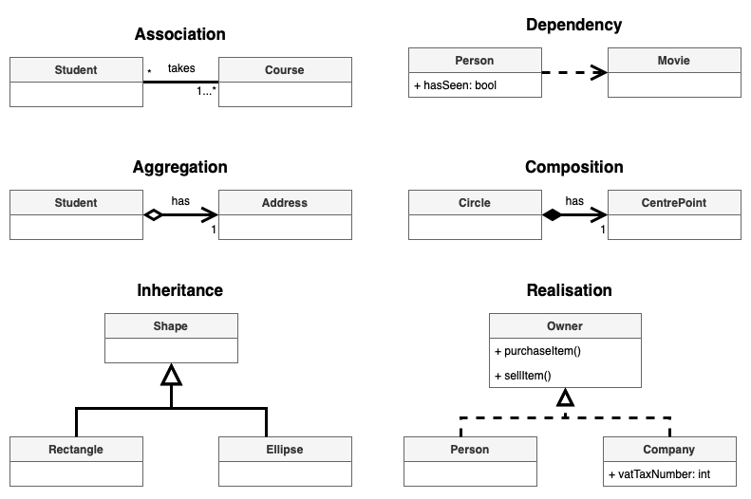
UML Relationships
Relationships between Classes:
Association – class knows about relationship with other class (f.e. student enroll in class)
Bidirectional Association - classes are aware of one another
Dependency - definition of class 2 depends on definition of class 1 (changes in class 1 effect class 2)
Aggregation – class 2 is part of class 1 but the class 2 can be independent (Library and Book)
Composition – class 2 cannot exist without class 1 (composed of)
Inheritance – class 2 and 3 are subclasses (children) of parent class, they extend the parent
Realization – class 1 is blueprint for class 2 and 3
https://www.drawio.com/blog/uml-class-diagrams

Slide 12
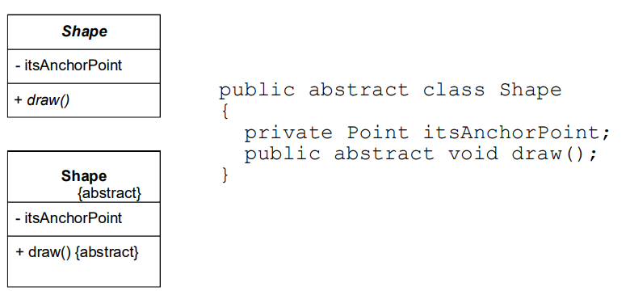
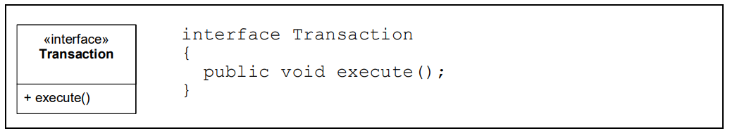
UML
Abstract classes
In UML there are two ways to denote that a class, or a method, is abstract.
You can write the name in italics, or you can use the {abstract} property
Interfaces
Typically shown with a stereotype <<interface>> or by using the << >> notation
UML for Java Programmers
UML for Java Programmers
*Word document: UML_relationships

Slide 13
Access Modifiers
Used to specify access level or visibility of the members of the class
Outer class can only default or public
Default
Public
Private
Protected
Members | default | public | private | protected
Inside class | Accessible | Accessible | Accessible | Accessible
Child class inside package | Accessible | Accessible | Not accessible | Accessible
Parent class inside package | Accessible | Accessible | Not accessible | Accessible
Child class in different package | Not accessible | Accessible | Not accessible | Accessible
Parent class in different package | Not accessible | Accessible | Not accessible | Not accessible

Slide 14
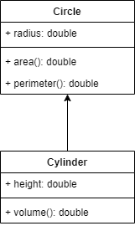
Inheritance
Process of acquiring features from existent class into new class
Parent (superclass, base) & child (subclass, derived)
Properties & methods from parent class are inherited by children
Subclass acquiring/having the features (methods & properties) of superclass
Constructors of parent and child (top->bottom)
Method overriding - redefining method
Method overriding with arguments*

Slide 15
Polymorphism
Polymorphism – one name different actions (means “many forms”)
Name is the same but actions are different
Using method overloading and method overriding
Which method is called is decided at compile time
Overloading achieved within same class & across classes
Overriding only in inheritance (parent & child)
*Methods that are marked as final can not be overridden
Program decides at runtime based on the object (dynamic polymorphism)

Slide 16




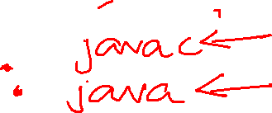


Polymorphism
//Overloading
class Test
{
public int max(int a,int b)
{
return a>b?a:b;
}
public int max(int a,int b,int c)
{
if(a>b && a>c) return a;
else if(b>c) return b;
return c;
}
}
public class Main
{
public static void main(String[] args)
{
Test t=new Test();
t.max(10,5);
t.max(10,15,5);
} }
//Overriding
class Super
{
private void display() {
System.out.println("Super display.");
}
}
class Sub extends Super
{
//@Override
public void display()
{
System.out.println("Sub display.");
}
}
public class Main {
public static void main(String[] args) {
Sub s=new Sub();
s.display();
} }

Slide 17
Abstract Classes
abstract class Animal {
abstract void makeSound();
void sleep() { System.out.println("sleeping.");
}}
class Dog extends Animal {
void makeSound() {
System.out.println("The dog says: Woof Woof"); }}
Abstract class with at least one undefined method is an abstract class
We have abstract and concrete classes
Cannot create instance (object) of abstract class
Only refences of abstract classes are allowed
Abstract class declaration has abstract keyword:
abstract class Super
Abstract method – method without function body, undefined method:
public abstract void abstractMethod(){ };
Child of abstract parent class is concrete if it has overridden the abstract method
Child class must override the abstract method from the parent. Otherwise, child class will become abstract
Abstract classes are best for creating a foundational class with shared behavior
Subclasses of abstract classes meant to follow the standarts set up in the abstract

Slide 18
Interfaces
interface Test1{}
class MyClass implements Test1{}
Interface is not a class (can’t construct interface objects)
All methods are abstract by default
Method inside an interface cannot have body but the method can have body if the method is static
Can contain only method signatures and final fields
Can make a reference but cannot be instantiated
It is implemented using implements keyword
When class implements interface, it becomes abstract (abstract keyword)
When you override all the methods, then class is concrete
Reference of interface can hold an object of a class
Test1 test = new MyClass();
Methods will be called based on object
Interfaces are to achieve runtime polymorphism, we need to override methods of interface
Interface can be extended from another interface
Class can implement multiple interfaces

Slide 19
Try/Catch block & Finally
try
{
//code
//more code
//more code
}
catch (ExceptionType e)
{
//handler for this type
}
Catch(NullPointer n){//}
finally{
//Executes always
}
Exception is an event, which occurs during the execution of a program, that disrupts the normal flow of the program's instructions.
The try block allows you to define code to be tested for errors while it is being executed.
The catch block allows you to define code to be executed, if an error occurs in the try block.
There can be multiple catch blocks to catch multiple exceptions
The code in the finally block executes no matter if of an exception was caught or not
There is a problem where code in finally block can overwrites the code from try or catch blocks
Best Practice: to catch specific exceptions

Slide 20
Throw an Exception
// Use of unchecked Exception
try {
// double x=3/0;
throw new ArithmeticException();
}
catch (ArithmeticException e)
{
//log of method calls of e
e.printStackTrace();
}
The throw keyword is used to throw an exception
The throws is used for declaring that a method may throw exception (written in the signature of the method)
When a method throws an exception, you are declaring that this method may throw an exception that it does not handle. This shifts the responsibility of handling the exception to the JVM, which will print the stack trace of the exception to the standard error stream if an exception is thrown and not caught within the method
When an exception is thrown and not caught within a method that declares throws Exception, the exception is propagated up the call stack (from method that occurred to method that called)

Slide 21
Exception Propagation & Chained Exception
public class StackTraceExample {
public static void main(String[] args) {
try {
method1();
} catch (Exception e) {
e.printStackTrace();
}
}
public static void method1() throws Exception {
method2();
}
public static void method2() throws Exception {
method3();
}
public static void method3() throws Exception {
throw new Exception("An error occurred in method3");
}
}
Exceptions propagate up the call stack if not caught, eventually terminating the program if not handled
Chained Exceptions are used to preserve the original cause of an error
When you create a new exception, you can pass the original exception (the cause) to it using one of its constructors
This allows you to maintain the stack trace of the original exception while providing more specific error information

Slide 22
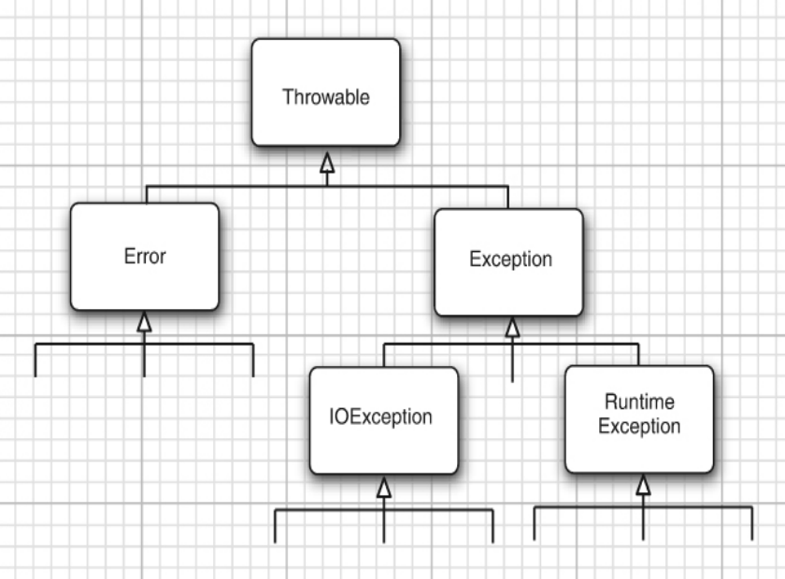



Exception Hierarchy & Checked/Unchecked Exceptions
Core Java Volume I: Fundamentals
Checked exception must be handle by try/catch block (compiler forces you to do it)
Unchecked exception are not compulsory to be handled
class IOException is the root class for various exception classes having to do with input and output
You can define your own exception:
class MyOwnException extends Exception{}
classNotFoundException
IOException
InterruptedException
NumberFormatException
RuntimeException
ArithmeticException (/ by 0)
NullPointerException (reference to null)

Slide 23
Class Exception
Exception is the parent class for all the exceptions
ClassNotFoundException this exception is raised when the object is used but the class is not found
IOException accessing input output, mostly accessing files where files are not there or file is corrupted one of the famous exception is the FileNotFoundException
InterruptedException it is related to Multithreading if a thread stops abnormally it throws an Interrupted exception
NumberFormatException when input is given as a number string form but not have a proper number, then it throws NumberFormatException
RuntimeExceptions under these there are ArithmeticExceptions, IndexOutOfBoundException, NullPointerException

Slide 24
Inner Classes
Class defined within another class
Non-static Inner classes
Defined within another class but outside any method
Have access to the outer class's members, including private ones
To instantiate, you need an instance of the outer class
Static Inner Classes
Defined with the static keyword
Do not have access to instance variables and methods of the outer class.
Can be instantiated without an instance of the outer class
Local Inner Classes
Defined within a block, such as a method or an if statement
Have access to local variables and parameters, but they must be final or effectively final (i.e., not changed after initialization)
Anonymous Inner Classes
A special kind of inner class without a name.
Often used for implementing interfaces or extending classes on the fly
*Code Example: Tutorial10_InnerClasses

Slide 25
Working with Files
We need java.io* and java.util.Scanner packages
To operate on files, we can create an object of class File
Useful methods :
createNewfile()
delete()
exists();
getAbsolutePath();
mkdir()
list()
To write to file, we use FileWriter class
To read from file, we use Scanner class
*Code Example: Tutorial7_Examples

Slide 26
BufferedReader
Buffer is a temporary memory area that holds the data
We instantiate BufferedReader class and use readLine keyword to read from file
We instantiate BufferedWriter class and use write keyword to write to file
Java offers multiple ways to perform file operations because each approach has its strengths and is designed to cater to different needs and use cases.
*Code Example: Tutorial_7

Slide 27
Binary Files
Binary files store data in the same format that is used in the computer’s memory to store the values of variables.
For example, a value of type int is stored as the same sequence of bytes (same sequence of zeros and ones) whether it is stored in an int variable in memory or in a binary file.
No conversion of any kind needs to be performed when you store or retrieve a value in a binary file -> binary files can be handled more efficiently than .txt files
A binary file created by a Java program can be moved from one computer to another and still be read by a Java program
We use stream classes ObjectInputStream and ObjectOutputStream for processing binary files
They read and write methods one byte at time
They convert numbers, characters, doubles into bytes to be stored in the binary file
They can also read and write objects of classes

Slide 28
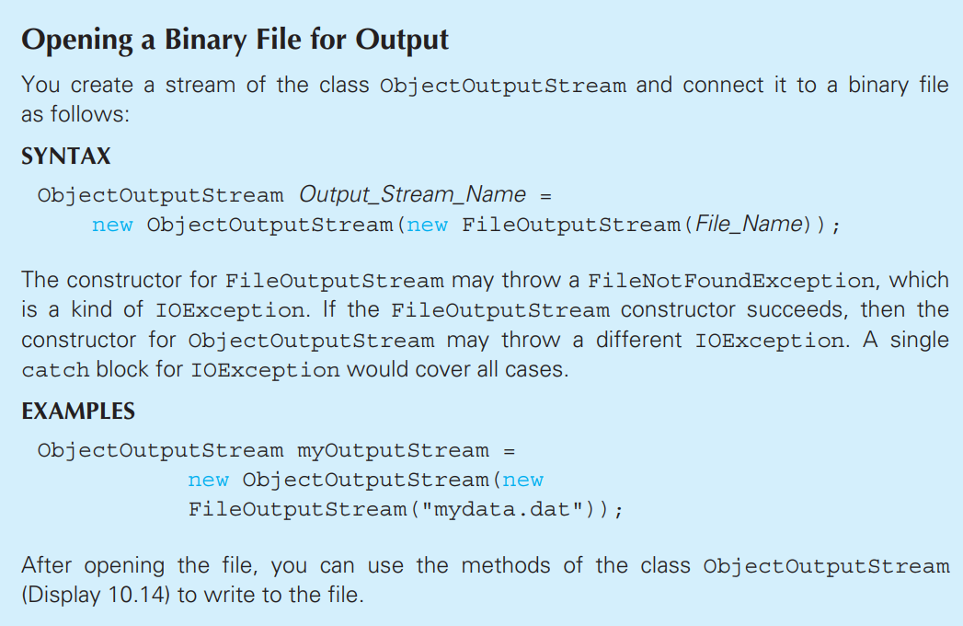
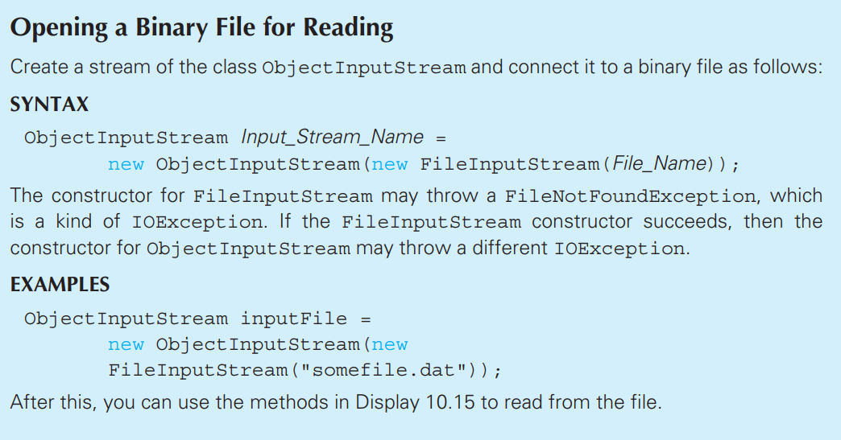


Opening Binary File for Writing & Reading
Absolute Java 6th edition
Absolute Java 6th edition
*Code Example: Tutorial8_BinaryFiles

Slide 29
Serializable
We can output objects of classes using Serializable interface
Import package java.io
We can create a class that implements Serializable interface:
public class Test implements Serializable{}
Definition: A class that implements the Serializable interface is said to be a serializable class
I/O with binary files using serializable class:
To write object of class into a binary file, we use writeObject
To read object of class from a binary file, we use readObject
*Code Example: Tutorial7_Serializable

Slide 30
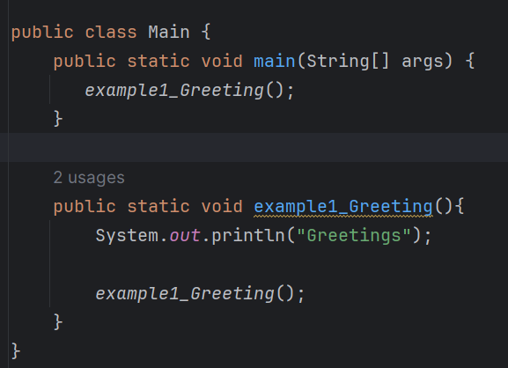

Recursion
When you have a method that calls itself (inside the method body)
Method definition that includes a call to itself is said to be recursive
Issue of infinite recursion that leads to Stack Overflow Error (like infinite while loop)
Way to break down complex problems, repetitive or hierarchical problems (divide-and-conquer algorithms, searching a list)
Example:

Slide 31

Recursion: Call Stack
When program encounters a recursive call, it temporarily stops its computation, because it must know the result of the recursive call before it can proceed
Stack is data structure (LIFO), memory structure that keeps track of recursive methods calls, local variables etc.
Stack may grow and shrink
Stack has limit
https://media.istockphoto.com/id/897711146/photo/files-stacked.jpg?s=612x612&w=0&k=20&c=lSCrKz68977MrhRUvN6vXm5LaBO0yu2aqyP9x4oc1pU=

Slide 32
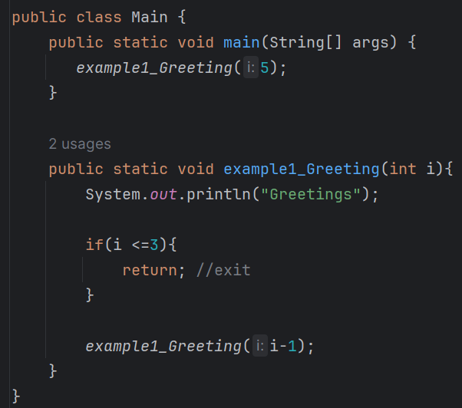
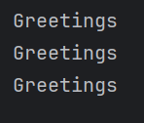
Recursion: Exit
You need a condition to safely exit the recursive method w/o causing it to run infinitely (stack overflow)
This is a job of the base case or stopping case where method accomplishes its task w/o making a recursive call
Example:
*Code example: Tutorial8_Recursion

Slide 33
Generics
public class Box<T> {
private T value;
public Box(T type){
this.value = type; }
public T getValue() {
return value; }
}
Generics enable types (classes and interfaces) to be parameters when defining classes, interfaces and methods
These type parameters are placeholders for actual data types that are specified when an object of the generic class is instantiated
If parameter is not given, by default it will be an Object
You can pass any number of parameters into generic class
Cannot use primitive types, Objects only!
Child class of Parent generic class is also a generic class
F.e. Class MyArray<T> extends GenericArray<T>
Box<Integer> integerBox = new Box<>();
Box<String> stringBox = new Box<>();
Generics accomplish:
Type Safety - catch type-related errors at compile (rather than runtime).
F.e., without generics, a collection like ArrayList would hold objects of type Object, and you would need to cast them to the correct type when retrieving elements -> ClassCastException
Generics enforce, ensuring that only objects of a specific type can be added to a collectiontype consistency
Code Reusability - write methods, classes, and interfaces that can operate on any data type which reduces code duplication and increases reusability
Elimination of Casts – no need to perform explicit casts when retrieving elements from a collection

Slide 34
Generics
Bounded Type parameters
You can restrict the types that can be passed to a generic class using bounded type parameters using extends keyword
It allows only classes that extending from Number class
F.e. T extends Number means that T must be a subclass of Number (e.g., Integer, Double, etc.).
This allows you to call methods defined in the Number class on T
public class NumberBox<T extends Number> {
private T value;
public Box(T type){
this.value = type; }
public T getValue() {
return value; }
}

Slide 35
Generics
Wildcard <?> represents an unknown type
Used in situations where you want to specify that a method can operate on a generic type, but you don't know or don't want to specify the exact type
Types:
Unbounded - when you want to allow any type to be used but don't need to use the type in a way that requires knowledge of its specific type
public void printBox ( Box<?> box ) {
System.out.println( box.getValue());}
Upper-Bounded - restricts the unknown type to be a subtype of a specified type T. This means that you can pass a type that is T or any subclass of T
public void printNumberBox(Box<? extends Number> box) {
System.out.println(box.getValue());}
Lower-Bounded - restricts the unknown type to be a supertype of a specified type T. This means that you can pass a type that is T or any superclass of T
public void addNumber(Box<? super Integer> box) {
box.setValue(10); //can add Integer }

Slide 36
Generic Methods
public static <T> void printArray(T[] array) {
for (T element : array) {
System.out.println(element);
} }
You can also define generic methods in both generic and non-generic classes. The type parameter is declared before the return type
Static and non-static generic methods are allowed
class GenericMethodExample {
public static <T> T echo(T input) {
return input; }
public static void main(String[] args) {
String echoedString = echo("Hello");
Integer echoedInteger = echo(123);
System.out.println(echoedString); // Output: Hello
System.out.println(echoedInteger); // Output: 123 }
public class BoundedTypeExample {
public static <T extends Number> void printDouble(T number) {
System.out.println(number.doubleValue());
}
public static void main(String[] args) {
printDouble(10); // Output: 10.0 (Integer as Number)
printDouble(5.5); // Output: 5.5 (Double as Number)
printDouble(3.14f); // Output: 3.14 (Float as Number)
// printDouble("Hello"); // Compilation error } }

Slide 37
Generic Methods
public class WildcardExample {
public static void printList(List<?> list) {
for (Object elem : list) {
System.out.println(elem);
}
}
public static void main(String[] args) {
List<String> stringList = List.of("apple", "banana", "cherry);
List<Integer> intList = List.of(1, 2, 3);
printList(stringList); // Output: apple, banana, cherry
printList(intList); // Output: 1, 2, 3
}}
Wildcards can be used in generic methods to provide more flexibility, especially when dealing with collections
In a wildcard type, a type parameter is allowed to vary
*Code Example: Tutorial10_Review

Slide 38
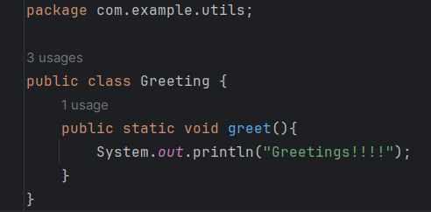
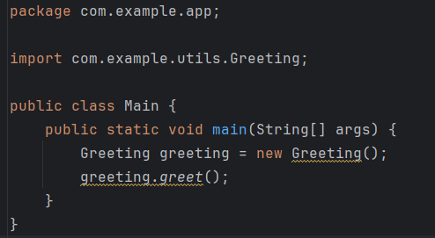
Package
src/com/example/
app/
Main.class
utils/
Greeting.class
It is collections of classes, interfaces
Used to organize java projects under a single namespace
It is basically a folder or directory
If you use a package statement, it must appear as the first non-comment in the file (this compilation unit is part of a library named package_name): package package_name
By putting package statement at the top, you are making the public class withing this compilation unit
Then if you want to use class from another package, you have to import it by putting at the top (after package statement if it is the case)
A package is a convenient way of grouping together many different classes that have a common purpose
We can also import standard java libraries
Members of classes in a given package that have the protected qualifier are available anywhere within the same package, and also from any subclass of a class in the given package that appears in another package.

Slide 39
Package
src/com/example/
app/
Main.class
utils/
Greeting.class
Package access allows you to group related classes together in a package so that they can easily interact with each other.
When you put classes together in a package, thus granting mutual access to their package-access members, you “own” the code in that package.

Slide 40
References
Core Java Volume I: Fundamentals
Absolute Java
Udemy Learn Java – Beginner to Master
A Brief Guide to the Standard Object Modeling Language 3rd Edition
UML for Java Programmers
Udemy Learn Java – Beginner to Master
Udemy UML Class Diagrams for Programmers
https://www.lucidchart.com/pages/uml-class-diagram
https://www.visual-paradigm.com/guide/uml-unified-modeling-language/uml-class-diagram-tutorial/
https://medium.com/@smagid_allThings/uml-class-diagrams-tutorial-step-by-step-520fd83b300b
https://www.geeksforgeeks.org/unified-modeling-language-uml-class-diagrams/

Slide 41

Have a Great Rest of the Summer!

